Slide 1
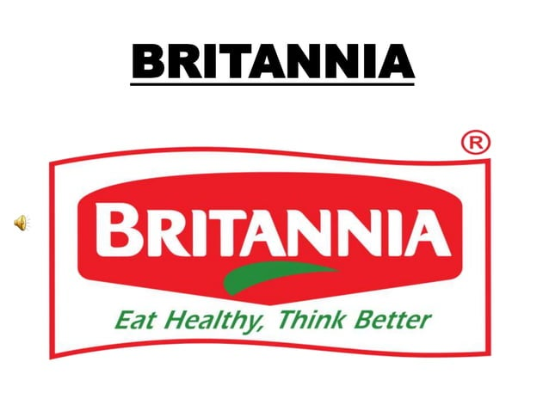
Presented by :
Y.SAI LAXMI (leader)
T.PAVITHRA
U.RAMYA
V.SYAMALA

Slide 2
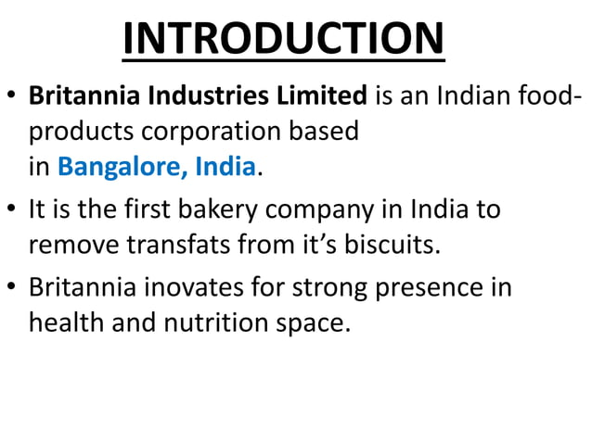

Slide 3
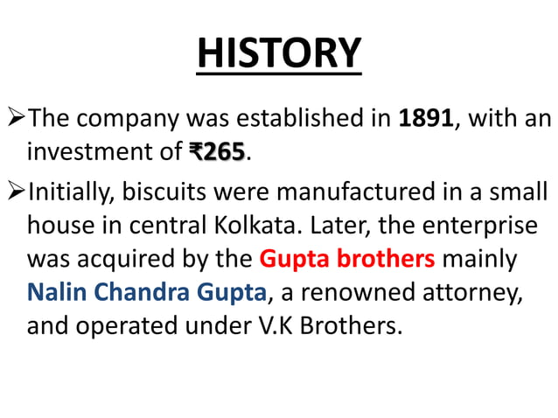

Slide 4
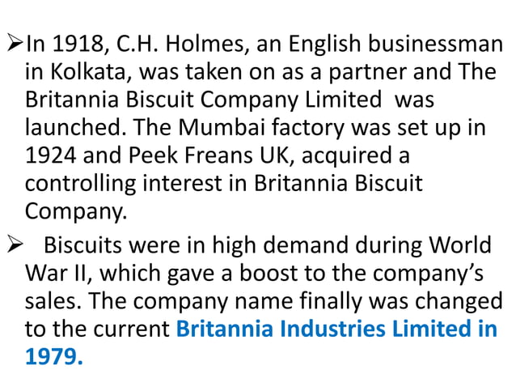

Slide 5
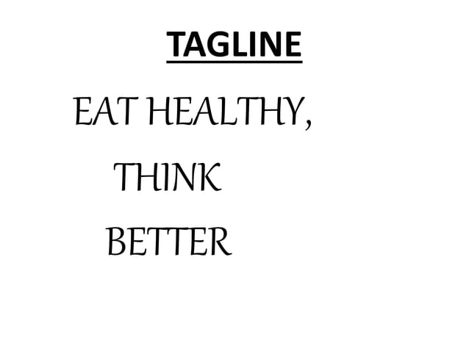

Slide 6
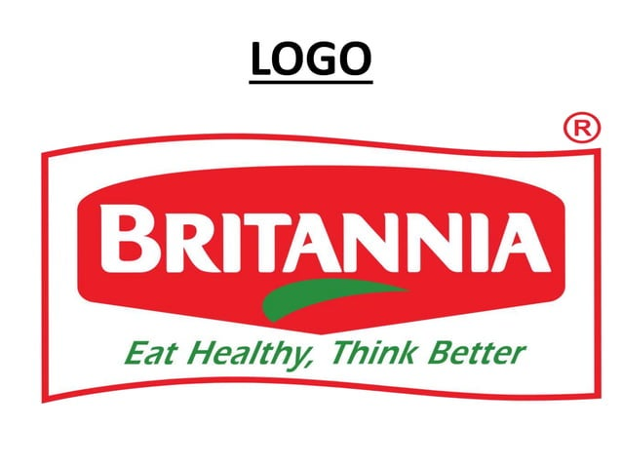

Slide 7
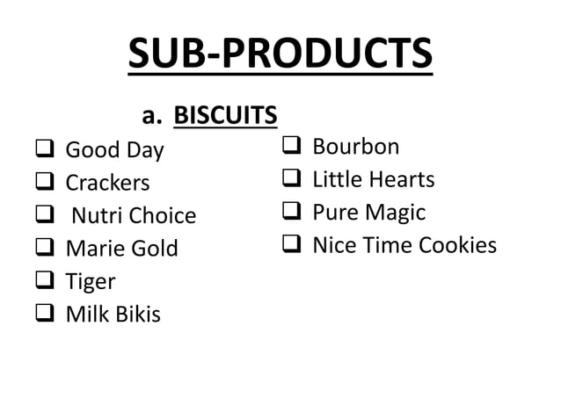

Slide 8
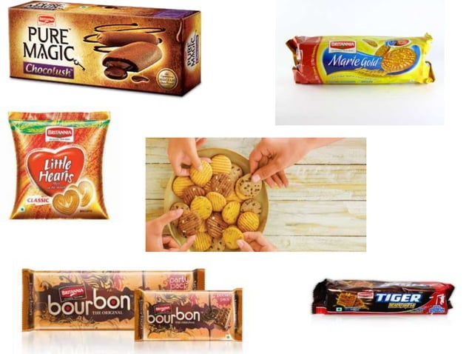

Slide 9
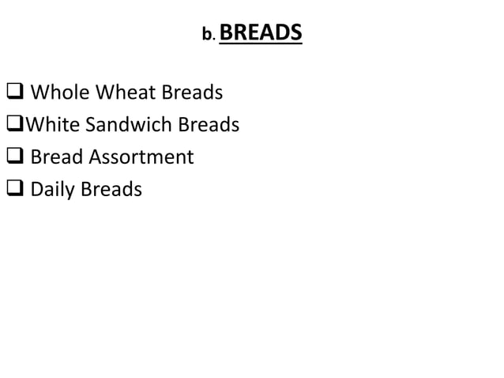

Slide 10
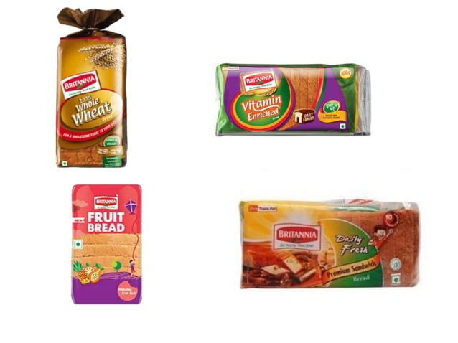

Slide 11
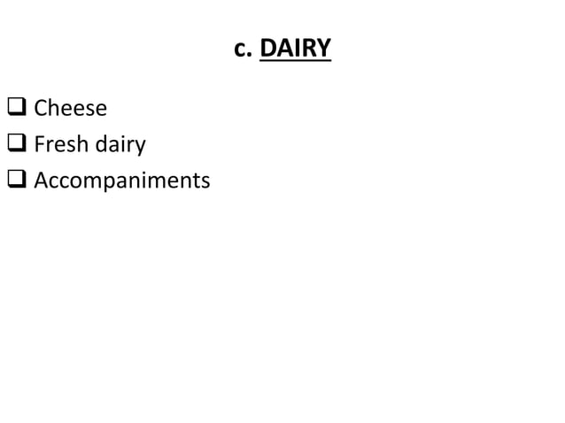

Slide 12
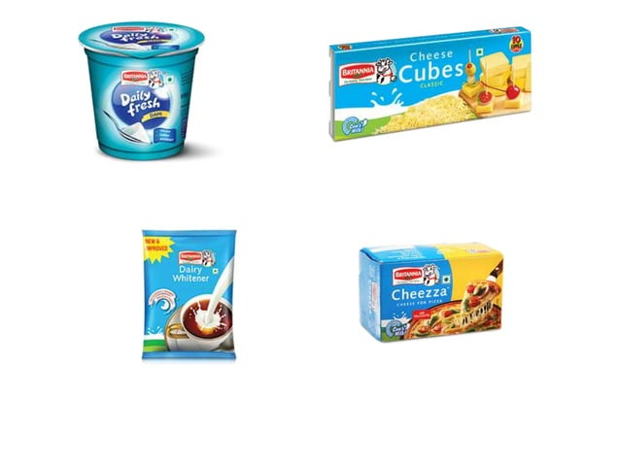

Slide 13
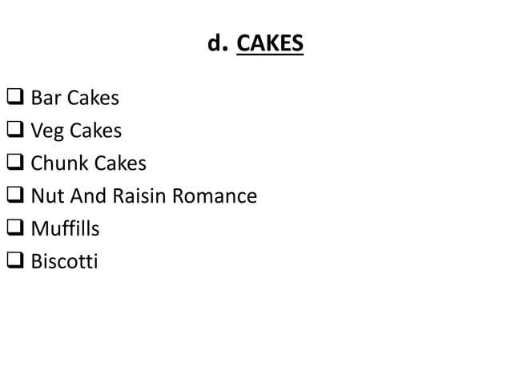

Slide 14
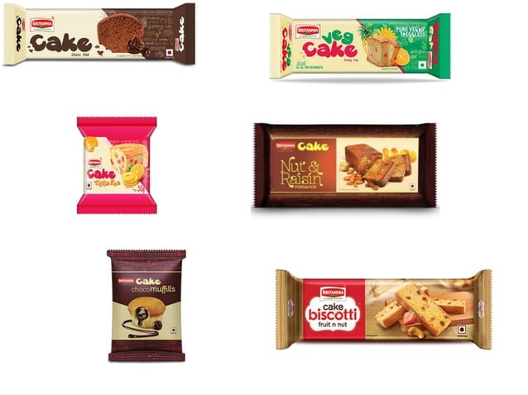

Slide 15
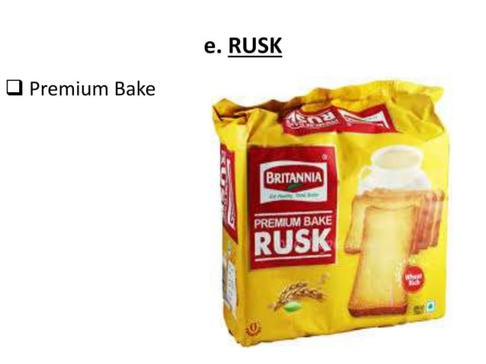

Slide 16
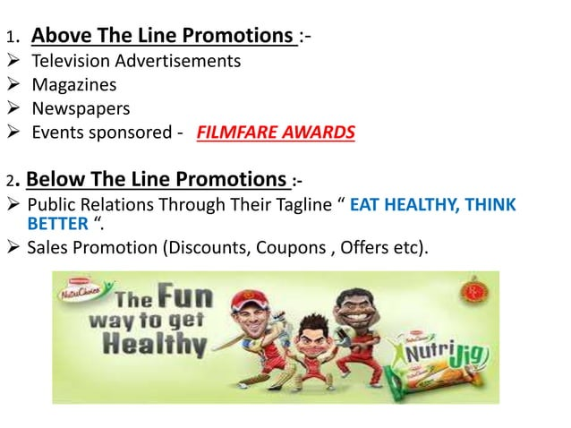

Slide 17
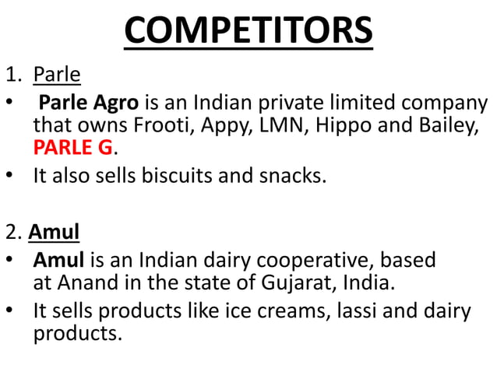

Slide 18
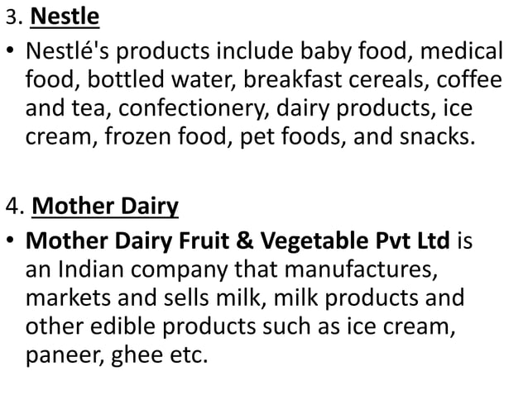

Slide 19
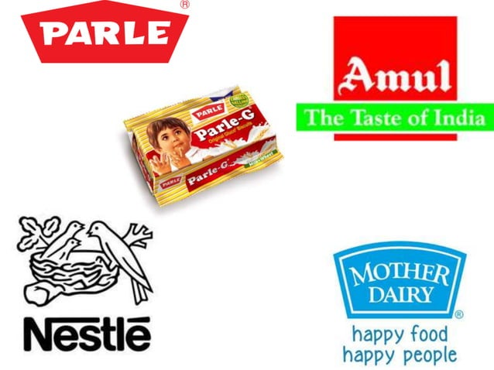

Slide 20
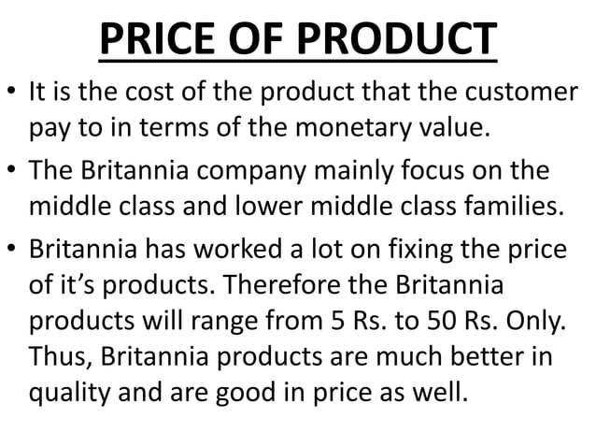

Slide 21
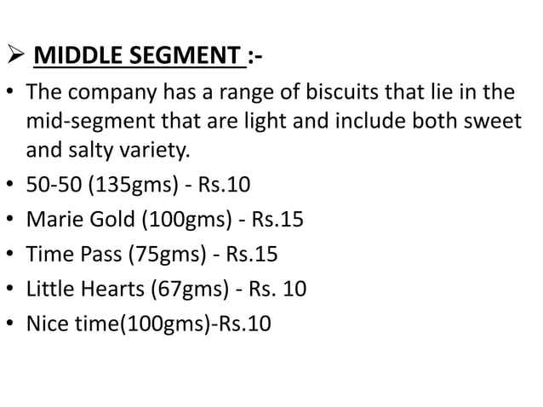

Slide 22
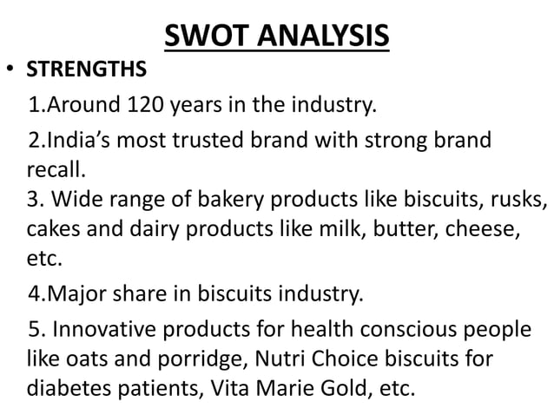

Slide 23
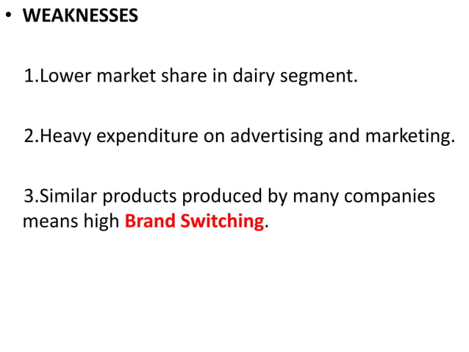

Slide 24
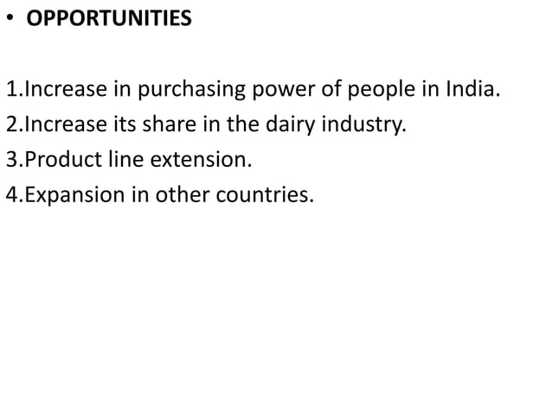

Slide 25
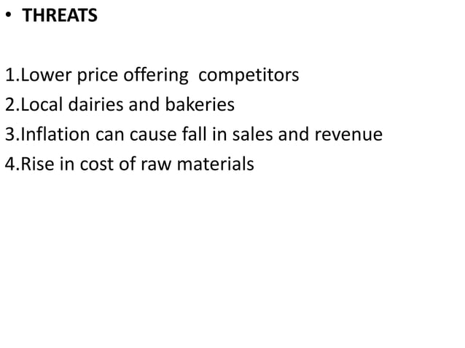

Slide 26
GOAL OF BRITANNIA
Britannia Industries Limited is a well-known Indian food company, and its goals typically revolve around various aspects of its business. While I don't have access to the company's most current strategic goals beyond my knowledge cutoff date in September 2021, here are some common goals that food companies like Britannia often pursue:
Revenue and Profit Growth: One of the primary goals for Britannia, like any business, would be to increase revenue and profitability. This involves expanding product lines, entering new markets, and optimizing operations.
Market Leadership: Britannia may aim to maintain or improve its position as a market leader in the Indian food industry, which could involve increasing market share.
Product Innovation: Developing and launching new and innovative food products to meet changing consumer preferences and needs.

Slide 27
Quality and Safety: Ensuring that all products meet high-quality standards and comply with food safety regulations and industry certifications.
Sustainability: Working towards sustainability goals, such as reducing the environmental footprint of production and adopting eco-friendly practices.
Customer Satisfaction: Focusing on customer satisfaction through quality products and exceptional customer service.
Global Expansion: Expanding its presence in international markets by exporting products or establishing a stronger global footprint.

Slide 28
KPI
Market Share: Measuring the company's share of the market in its industry.
Revenue and Sales Growth: Tracking the company's revenue and sales growth on a quarterly and annual basis.
Profit Margin: Monitoring the gross and net profit margins to assess the company's profitability.
Brand Awareness and Brand Equity: Assessing the strength of the Britannia brand through customer surveys and market research.
Key Performance Indicators (KPIs) for a company like Britannia Industries Limited, which is a major player in the Indian food industry, can include a variety of metrics to measure its performance. Some common KPIs for Britannia may include
Customer Satisfaction: Measuring customer satisfaction through surveys and feedback

Slide 29
.Production Efficiency: Monitoring production efficiency and cost per unit.
Inventory Turnover: Evaluating how quickly inventory is sold or used.Employee Productivity and Satisfaction: Assessing employee productivity and job satisfaction, which can impact overall performance.
Quality Control: Tracking product quality and consistency.
Sustainability Metrics: Measuring environmental and social responsibility efforts, such as reducing waste, energy consumption, and carbon emissions.
Distribution and Supply Chain Efficiency: Monitoring the efficiency of distribution and supply chain operations.New Product
Development and Innovation: Measuring the success of new product launches and innovation initiatives.It's important to note that specific KPIs can vary based on the company's strategic objectives and industry trends. Britannia Industries would likely use a combination of these and other relevant KPIs to assess and improve its performance.

Slide 30
SEO OF BRITANNIA
Search Engine Optimization (SEO) is a crucial digital marketing strategy that helps companies improve their online visibility and organic search rankings. While I don't have access to Britannia's specific SEO strategies, I can provide some general insights into what a company like Britannia might consider for SEO:
Keyword Optimization: Identify relevant keywords related to their products and industry. This includes both branded keywords (e.g., "Britannia biscuits") and non-branded keywords (e.g., "healthy snacks").
On-Page SEO: Optimize website content, including product descriptions and blog posts, by using targeted keywords, meta tags, and header tags. Ensure that the content is high-quality and provides value to users.
Mobile-Friendly Design: Ensure the website is responsive and mobile-friendly, as Google prioritizes mobile optimization in its search rankings.

Slide 31
Site Speed: Improve website loading speed for a better user experience and to meet Google's site speed requirements.
Quality Backlinks: Acquire high-quality backlinks from reputable websites in the food and related industries. These backlinks can boost the website's authority and search engine rankings.
Content Marketing: Develop a content marketing strategy that includes blog posts, articles, videos, and infographics related to their products and industry. Fresh, informative content can attract and engage users.
Local SEO: If Britannia has physical stores or retail locations, optimize for local search by creating and maintaining Google My Business listings and other local directories.
Social Media: Engage in social media marketing to promote content and interact with customers. Social signals can indirectly impact SEO.

Slide 32
BRAND STUDY OF BRITANNIA
A brand study of Britannia would typically involve an in-depth analysis of the company's brand identity, market positioning, and consumer perception. Here are some key points to consider:
Brand History: Britannia has a long and established history in India, dating back to 1892. Understanding its historical journey and evolution is crucial.
Brand Identity: Examine Britannia's brand logo, slogans, and visual elements to understand its brand identity. The "Britannia Khao, World Cup Jao" slogan is one example of their marketing campaigns.
Product Portfolio: Britannia offers a wide range of products, including biscuits, cakes, dairy products, and bread. Analyze their product offerings and their market share in each category.

Slide 33
Market Positioning: Determine how Britannia positions itself in the market. Is it a value-for-money brand, a premium one, or something in between?
Competitive Analysis: Study how Britannia competes with other brands in the FMCG (Fast-Moving Consumer Goods) sector, especially against rivals like Parle, ITC, and Mondelez.
Consumer Perception: Look into how consumers perceive the brand. This can be done through surveys, social media sentiment analysis, and consumer reviews.
Marketing Strategies: Investigate Britannia's marketing and advertising strategies. This could include their digital presence, television commercials, and sponsorships.
CSR and Sustainability: Assess their initiatives related to corporate social responsibility and sustainability, as these can significantly impact brand perception.

Slide 34
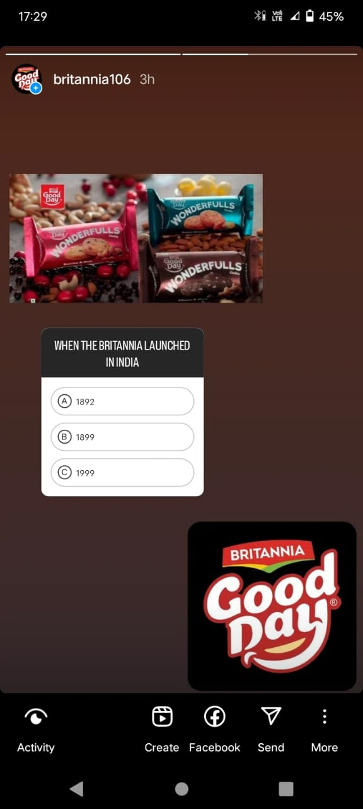
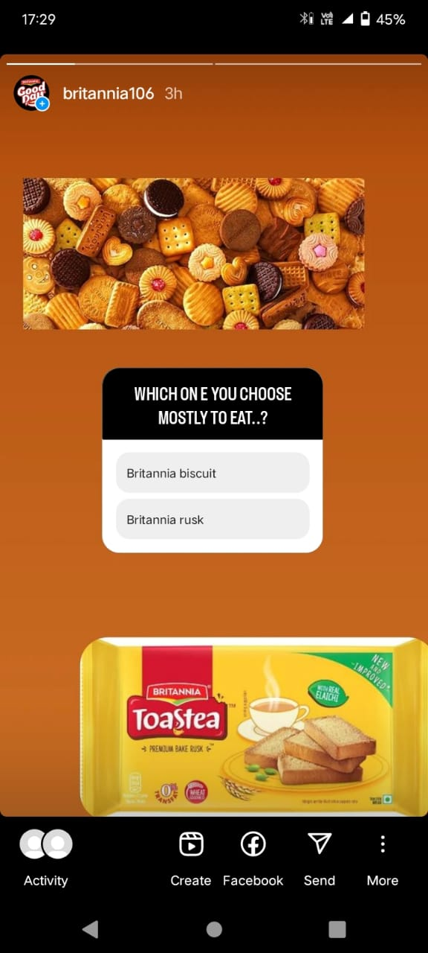
Watch my Instagram story:

Slide 35
Watch my Instagram story links:
https://instagram.com/stories/britannia106/3211846069596308376?utm_source=ig_story_item_share&igshid=NjZiM2M3MzIxNA==
https://instagram.com/stories/britannia106/3211835297986142986?utm_source=ig_story_item_share&igshid=NjZiM2M3MzIxNA==

Slide 36
THANK YOU

